Slide 1
Impact of COVID-19 on ABC Company Parcel Business
190,719
Total records
Weekly customer shipment rows
1,061
Step-by-step analysis of parcel volume, customer behavior, peak season performance, and business impact
Customers analyzed
Unique FakeCustomerID values
2018–2021
A PROJECT WORK BY
SAMUEL ESSIEN
NNAEMKEA CHARLES ADIBE
Years covered
Pre-COVID, COVID, and normalization period
Notes:
Opening: This presentation explains how COVID-19 changed ABC Company's parcel business. The story moves from the baseline, to the timing of the impact, to peak season, then to customer segment behavior and business implications.

Slide 2
Objective
This analysis examines the impact of COVID-19 on ABC Company’s parcel delivery business.
We aim to:
Evaluate changes in parcel volumes before and during COVID-19
Identify when the impact began
Analyze peak season performance
Identity how revenue was impacted
Assess customer growth and behavior across customer segments.

Slide 3
STEP 1
Dataset overview and analytical scope
Weekly parcel shipments by customer, year, week, and volume.
190,719
1,061
2018–2021
640,590
Rows
Unique customers
Time coverage
Max weekly volume
Granular weekly records
Customer-level tracking
Before, during, after COVID
Largest row volume
Fields used in this analysis
FakeCustomerID
THE_YEAR
THE_WEEK
VOLUME
Analysis period split: Pre-COVID baseline, COVID observation period, peak season, and post-2020 normalization.
Key takeaway: The dataset supports robust trend and segmentation analysis, but it does not include a direct revenue column.
Impact of COVID-19 on ABC Company Parcel Business
3
Notes:
The dataset has four columns: customer ID, year, week, and volume. It is strong for shipment-volume analysis. Because revenue is not directly provided, the deck treats parcel volume as a revenue proxy and avoids unsupported claims about actual dollars.

Slide 4
STEP 2
Build the normal-growth baseline: ISGR = 11.4%
Early 2019 vs early 2020 is used as the pre-COVID benchmark.
11.4%
Baseline growth rate
Industry Standard Growth Rate
Why this matters
Any customer or segment growing above 11.4% during COVID is treated as likely having pandemic-driven demand beyond normal business expansion.
Key takeaway: The baseline prevents over-attributing normal business growth to COVID.
Impact of COVID-19 on ABC Company Parcel Business
4
Notes:
The pre-COVID volume increased from 13.1M parcels in early 2019 to 14.6M in early 2020, which equals 11.4% growth. That is the threshold used to separate normal growth from likely COVID-driven growth.

Slide 5
STEP 3
Annual parcel volume: 2020 is the major inflection point
Volumes surged in 2020, then normalized in 2021.
Year-over-year change
2019 vs 2018
+7.6%
2020 vs 2019
+39.1%
2021 vs 2020
−33.8%
Interpretation: 2020 shows a structural demand shock consistent with COVID-driven e-commerce and delivery demand. The 2021 decline suggests normalization after the peak.
Key takeaway: 2020 volume was 73.5M parcels, up 39.1% from 2019.
Impact of COVID-19 on ABC Company Parcel Business
5
Notes:
This is the core annual result. Parcel volume rose from 52.8M in 2019 to 73.5M in 2020. The decline in 2021 should be framed as normalization rather than necessarily weakness, because 2020 was exceptional.

Slide 6
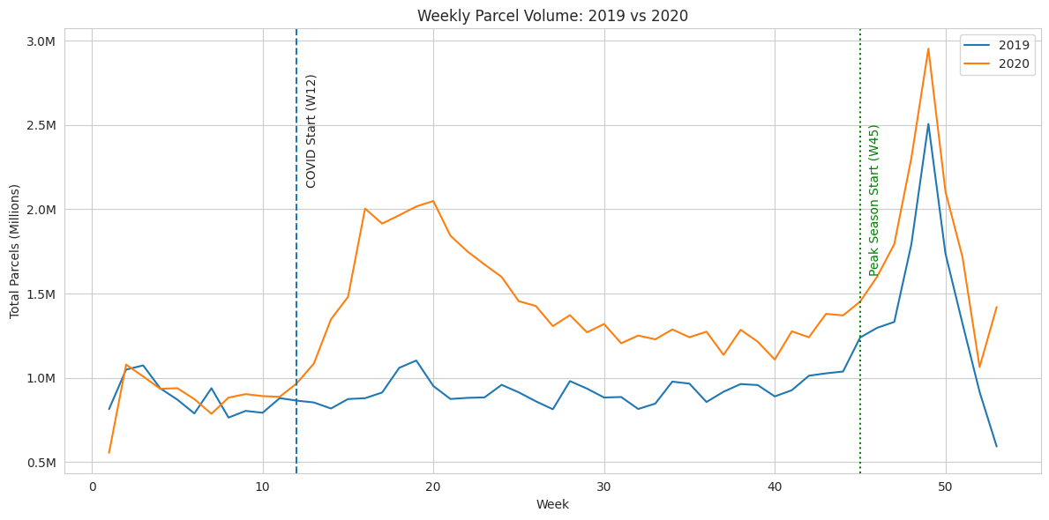
STEP 4
Weekly trend: the COVID impact begins around Week 12
The divergence between 2019 and 2020 becomes clear after the lockdown period.
Evidence around onset
W12
+11.9%
COVID onset marker
W14
+64.6%
Sharp acceleration
W16
+127.9%
Largest early divergence
W20
+115.4%
Demand remained elevated
Key takeaway: After Week 12, 2020 volumes stay consistently above 2019, signaling a sustained behavioral shift.
Impact of COVID-19 on ABC Company Parcel Business
6
Notes:
Week 12 is used as the COVID observation starting point. The line chart shows that the 2020 line pulls away from 2019 immediately after the onset. Week 16 is especially strong, with volumes more than double the same week in 2019.

Slide 7
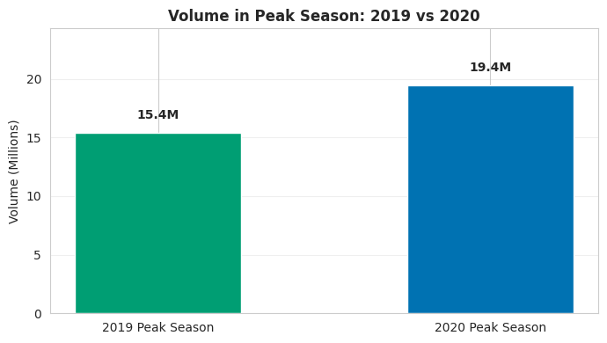
STEP 5
Peak season: 2020 outperformed 2019 by 26.5%
Holiday-season parcel demand intensified during the pandemic year.
15.4M
2019 peak season
Weeks 45–53 plus following weeks 1–3
19.4M
2020 peak season
Same cross-year peak-window definition
+26.5%
Peak season change
Extra 4.1M parcels vs 2019 peak
Key takeaway: COVID amplified the already-critical peak season, creating higher operational pressure and capacity requirements.
Impact of COVID-19 on ABC Company Parcel Business
7
Notes:
Peak season increased from 15.4M to 19.4M parcels. This means the business had to handle about 4.1M more parcels during its most operationally sensitive window.

Slide 8
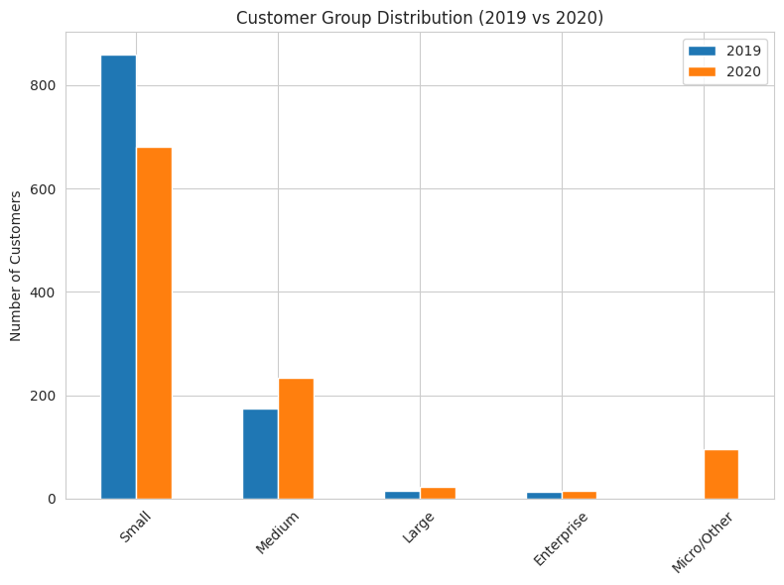
STEP 6
Customer segmentation: customer mix shifted in 2020
Customers were grouped by annual volume to show movement across size tiers.
Notable movements
• Small customers fell from 860 to 681 as many moved up or down in activity.
• Medium customers rose from 174 to 234, indicating expansion among smaller accounts.
• Large and Enterprise segments both grew slightly in customer count.
• Micro/Other appeared in 2020 with 95 customers, showing uneven demand effects.
Key takeaway: COVID did not only increase volume; it changed the composition of the customer base.
Impact of COVID-19 on ABC Company Parcel Business
8
Notes:
This slide looks at customer count by size group, not total volume. The customer base changed in composition, with more customers showing medium-size behavior in 2020 and some falling into micro/other.

Slide 9
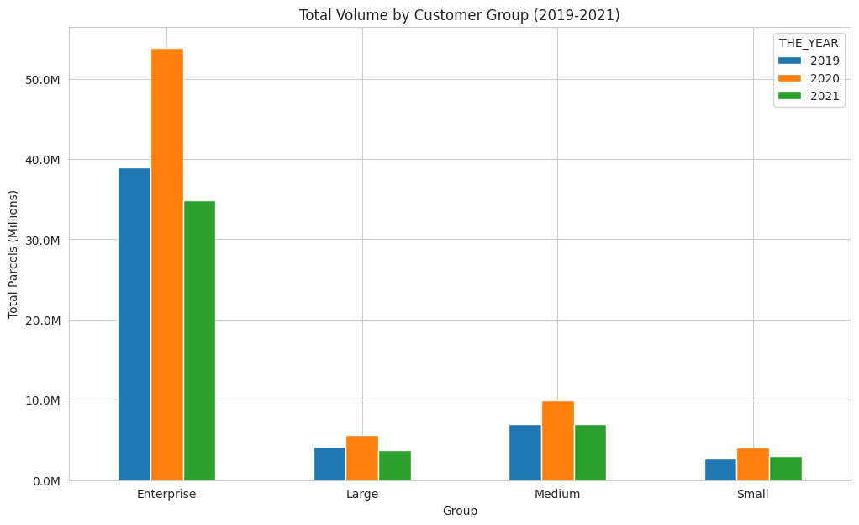
STEP 7
Impact by customer group: Enterprise dominates volume
All groups increased in 2020, but the volume base remains concentrated.
Segment interpretation
Enterprise
Largest total volume and the biggest absolute swing.
Large
Small customer count, but important growth signal.
Medium
Meaningful contribution and a clear 2020 uplift.
Small
Lower volume individually, but broad base and high variability.
Key takeaway: COVID created a broad uplift, but operational risk is concentrated in high-volume Enterprise accounts.
Impact of COVID-19 on ABC Company Parcel Business
9
Notes:
Enterprise customers represent a small number of accounts but dominate parcel volume. The 2020 uplift appears across segments, which supports the interpretation that this was a structural market shock rather than a single-customer anomaly.

Slide 10
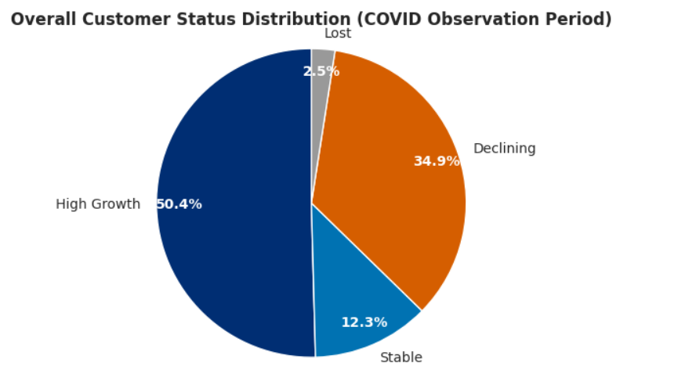
STEP 8
Customer status: high growth was the dominant pattern
Customers were classified as High Growth, Stable, Declining, or Lost during COVID.
Classification logic
High Growth = growth above the ISGR threshold during the COVID observation period. Stable = 0% to ISGR. Declining = negative growth. Lost = had volume in 2019 but zero during COVID.
58%
Enterprise high growth
7 of 12 customers
60%
Large high growth
9 of 15 customers
Key takeaway: Every segment had a majority or near-majority of customers in High Growth, but declining customers still require targeted retention.
Impact of COVID-19 on ABC Company Parcel Business
10
Notes:
This is the customer-level view. High growth is strongest in the Large and Enterprise segments. However, a substantial share of Medium and Small customers declined, so the business impact was positive overall but uneven across customers.

Slide 11
Customer Distribution by Group
Key takeaway: Growth exists across all groups, but small customers dominate volume and variability.

Slide 12
Impact of COVID on Volume by Customer Group
• All groups grew in 2020 vs 2019
• Medium (+41.8%) and Small (+51.9%) show strongest relative growth
• Enterprise contributes the largest absolute increase
Key takeaway: COVID drove broad volume growth; Enterprise leads in scale while Small/Medium lead in growth rate.

Slide 13
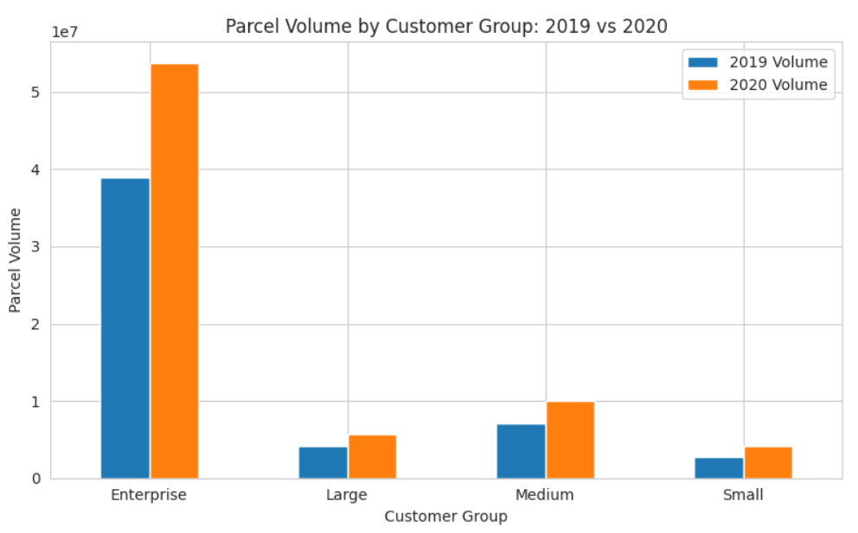
Parcel Volume by Customer Group (2019 vs 2020)
All customer groups experienced volume growth in 2020
Enterprise contributed the highest total volume
Medium and Small segments showed strong growth
Key takeaway: COVID significantly increased parcel volume across all segments, with Enterprise driving scale and smaller groups driving growth rate

Slide 14
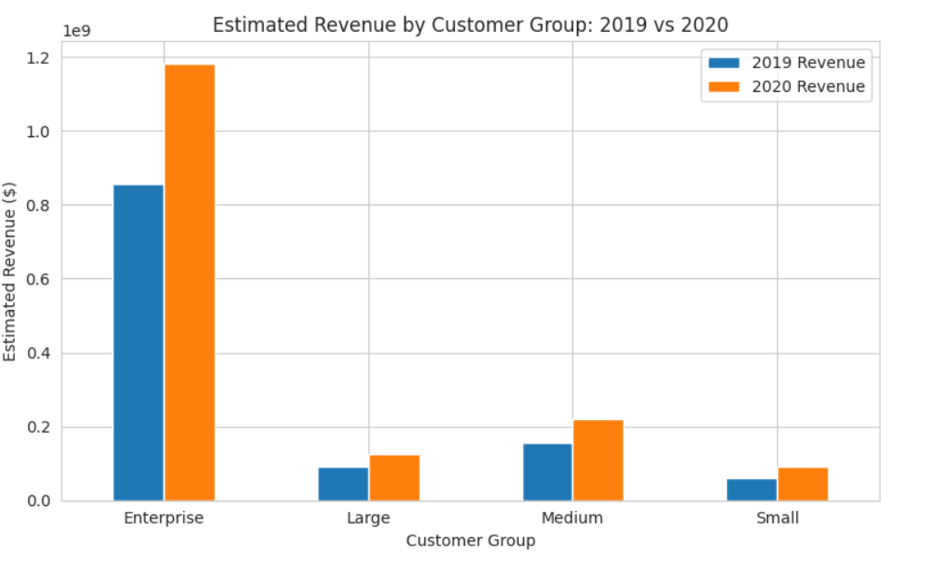
Estimated Revenue by Customer Group (2019 vs 2020)
Revenue increased across all customer groups in 2020
Enterprise generated the highest total revenue
Medium and Small segments showed strong growth
Key takeaway: Revenue growth was driven by increased parcel volume, with Enterprise leading in total contribution and smaller segments showing strong relative growth

Slide 15
BUSINESS ANSWERS
COVID impact began around Week 12 (March 2020)
Driven by lockdowns and e-commerce growth
Peak season increased by 26.5%
Majority of customers experienced high growth
Revenue increased due to higher parcel volume

Slide 16
FINAL
Conclusion: COVID created a structural demand shock
The evidence is consistent across annual volume, weekly onset, peak season, and customer status.
Main findings
Bottom line
+39.1%
Week 12
ABC Company should treat the 2020 surge as more than a temporary spike: it reveals customer behavior changes, capacity stress points, and account-level growth opportunities that can guide future planning.
2020 YoY volume growth vs 2019
Timing of sustained divergence
+26.5%
High Growth
Peak season growth in 2020
Dominant status across customer segments
Thank you
Key takeaway: Strong volume growth is the headline; customer segmentation is the path to action.
Impact of COVID-19 on ABC Company Parcel Business
12
Notes:
Close by emphasizing the integrated story: the annual spike identifies the scale, the weekly chart identifies the timing, peak season shows operational impact, and customer status shows where to target retention and growth.

